Slide 1
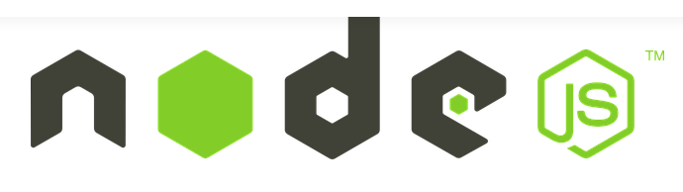
Server Side Javascript

Slide 2
NODE JS
Node.js is an open source and cross-platform runtime environment for executing Java scriptcode outside of a browser.
Is a server side Java script.
Created by Ryan Dahl in 2009.
Runs on Google's V8 JavaScript Engine.
V8 is a open source Java script engine developed by Google. It is written in C++ and is used in Google Chrome Browser.

Slide 3
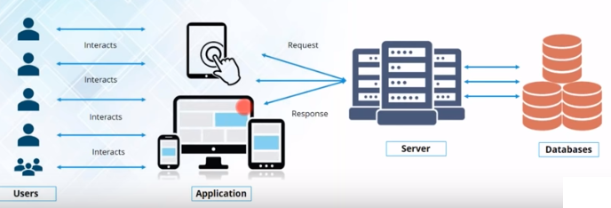
Client Server Architecture

Slide 4
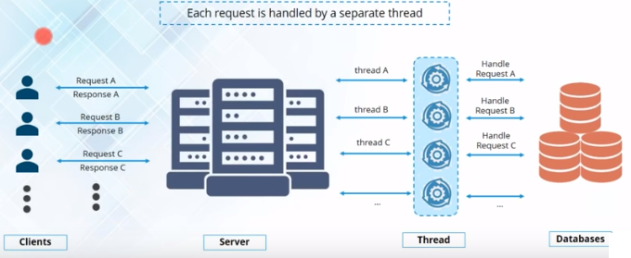
MultiThread Model
Limitation 1: Threads in the Thread pool are limited and as the number of requests exceed the no of threads, threads are exhausted.

Slide 5
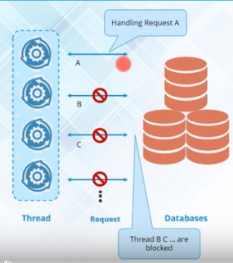
MultiThread Model
Limitation 2: If a thread acquires a lock of the shared resource, it is a exclusive lock. It will block other threads from accessing the resource.
This will affect the response time of the server.

Slide 6
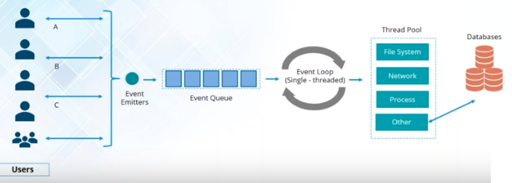
Single Threaded Model
Node JS is event driven, handling all request asynchronously from single thread.

Slide 7
Blocking code vs Nonblocking code
Blocking Code
NonBlocking Code
Read the file from the File System, when done reading the contents,
Print the contents.
Do something else
Read the file from the File System,
Whenever you are complete, Print the contents.
Do something else
This is a callback function

Slide 8
Blocking Code
var contents = fs.readFileSync(“filename”);
Console.log(contents);
console.log(“Do something else”);
Non Blocking Code
fs.readFile(“filename”, function (err, contents){
console.log(contents);
}
console.log(“DO something else”);

Slide 9
Why Node JS?
● Non Blocking I/O
● V8 Javascript Engine
● Single Thread with Event Loop
● 40,025 modules
● Windows, Linux, Mac
● 1 Language for Frontend and Backend
● Active community

Slide 10
Who Uses Node.js?
Node.js quickly gained popularity among a wide variety of companies. These companies use Node.js first and foremost for scalability but also for ease of maintenance and faster development.
The following are just a few of the companies using the Node.js technology:
Yahoo!
LinkedIn
eBay
New York Times
Dow Jones
Microsoft

Slide 11
What Can Node.js Do?
Node.js can generate dynamic page content
Node.js can create, open, read, write, delete, and close files on the server
Node.js can collect form data
Node.js can add, delete, modify data in your database

Slide 12
What Is Node.js Used For?
Node.js can be used for a wide variety of purposes. Because it is based on V8 and has highly optimized code to handle HTTP traffic, the most common use is as a webserver. However, Node.js can also be used for a variety of other web services such as:
Web services APIs such as REST
Real-time multiplayer games
Backend web services such as cross-domain, server-side requests
Web-based applications
Multiclient communication such as IM

Slide 13
What Does Node.js Come With?
Node.js comes with many built-in modules available right out of the box. This book covers many but not all of these modules:
Assertion testing: Allows you to test functionality within your code.
Buffer: Enables interaction with TCP streams and file system operations.
C/C++ add-ons: Allows for C or C++ code to be used just like any other Node.js module.
Child processes: Allows you to create child processes. Cluster: Enables the use of multicore systems. Command line options: Gives you Node.js commands to use from a terminal.
Console: Gives the user a debugging console.
Crypto: Allows for the creation of custom encryption. Debugger: Allows
Debugging of a Node.js file

Slide 14
DNS: Allows connections to DNS servers.
Errors: Allows for the handling of errors.
Events: Enables the handling of asynchronous events.
File system: Allows for file I/O with both synchronous and asynchronous methods.
Global: Makes frequently used modules available without having to include them first.
HTTP: Enables support for many HTTP features.
HTTPS: Enables HTTP over the TLS/SSL.
Modules: Provides the module loading system for Node.js.
Net: Allows the creation of servers and clients.
OS: Allows access to the operating system that Node.js is running on.
Path: Enables access to file and directory paths.
Process: Provides information and allows control over the current Node.js process.
Query strings: Allows for parsing and formatting URL queries. (See Chapter

Slide 15
Readline: Enables an interface to read from a data stream.
REPL: Allows developers to create a command shell.
Stream: Provides an API to build objects with the stream interface.
String decoder: Provides an API to decode buffer objects into strings.
Timers: Allows for scheduling functions to be called in the future.
TLS/SSL: Implements TLS and SSL protocols.
URL: Enables URL resolution and parsing.
Utilities: Provides support for various apps and modules.
V8: Exposes APIs for the Node.js version of V8.
VM: Allows for a V8 virtual machine to run and compile code.
ZLIB: Enables compression using Gzip and Deflate/Inflate.

Slide 16
Installation of Node JS
Download from official site
https://nodejs.org/en/download/
Node is command line, on successful installation open cmd and check version using the command
node –v

Slide 17
The following list describes the executables in the Node.js install location that you need to get started:
node: This file starts a Node.js JavaScript VM. If you pass in a JavaScript file location, Node.js executes that script. If no target JavaScript file is specified, then a script prompt is shown that allows you to execute JavaScript code directly from the console.
npm: This command is used to manage the Node.js packages
node_modules: This folder contains the installed Node.js packages. These packages act as libraries that extend the capabilities of Node.js.

Slide 18
Getting Started with Node JS: First Node JS program
A Node.js application consists of the following three important components −
Import required modules − We use the require directive to load Node.js modules.
Create server − A server which will listen to client's requests similar to Apache HTTP Server.
Read request and return response − The server created in an earlier step will read the HTTP request made by the client which can be a browser or a console and return the response.
Run program first.js

Slide 19
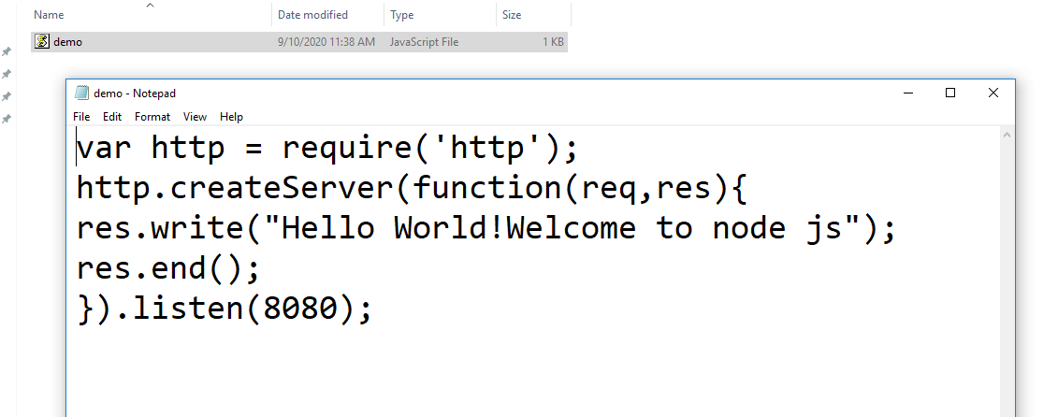

Slide 20
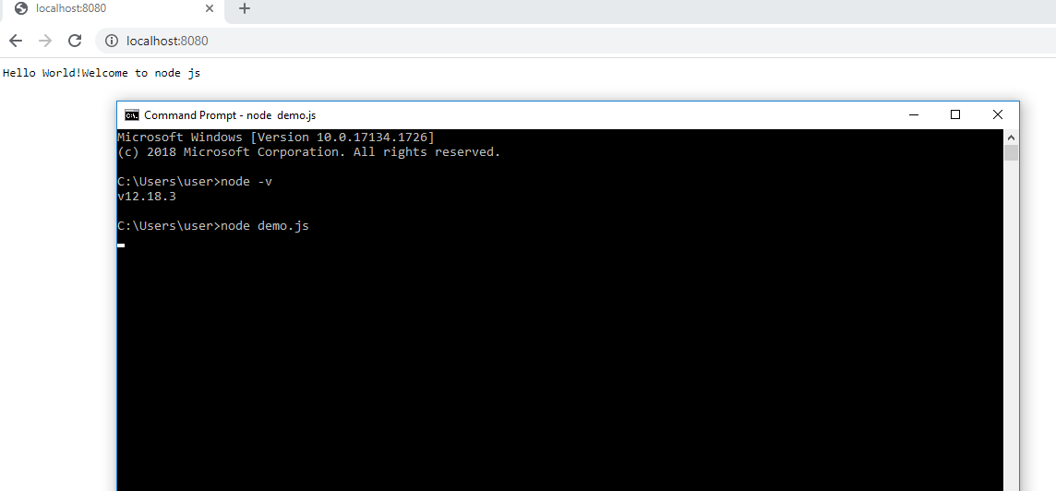

Slide 21
First.js
var http = require("http");
http.createServer(function (request, response) {
// Send the HTTP header
// HTTP Status: 200 : OK
// Content Type: text/plain
response.writeHead(200, {'Content-Type': 'text/plain'});
// Send the response body as "Hello World"
response.end('Hello World\n');
}).listen(8081);
// Console will print the message
console.log('Server running at http://127.0.0.1:8081/');

Slide 22
HTTP response status codes indicate whether a specific HTTP request has been successfully completed.
Responses are grouped in five classes:
Informational responses (100–199),
Successful responses (200–299),
Redirects (300–399),
Client errors (400–499),
and Server errors (500–599).

Slide 23
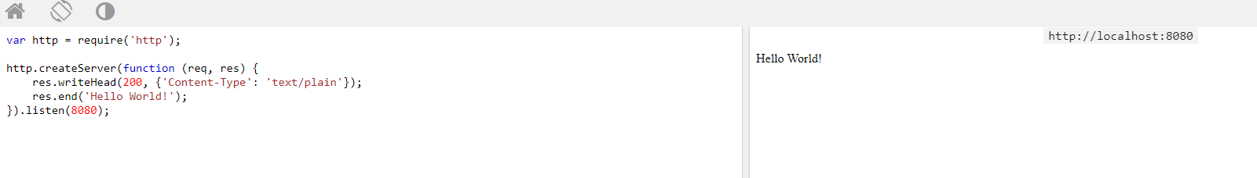

Slide 24
Examples Running in the Command Line Interface

Slide 25
Step 1: import modules
Modules are considered same as JavaScript libraries. They are a set of functions you want to include in your application.
Node.js has a set of built-in modules which you can use without any further installation.
events : To handle events
fs: To handle the file system
http: To make Node.js act as an HTTP server
https: To make Node.js act as an HTTPS server.
net: To create servers and clients
os: Provides information about the operation system
path: To handle file paths
To include a module, use the require() function with the name of the module:
var http = require('http');

Slide 26
You can create your own modules, and easily include them in your applications.
Example
Create a module that returns the current date and time:
exports.myDateTime = function () { return Date(); };
Use the exports keyword to make properties and methods available outside the module file.
Save with myfirstmodule.js extension
Include your module in the application as
var dt = require('./myfirstmodule');
Run program ownmodule.js → module name - firstmosdule.js

Slide 27
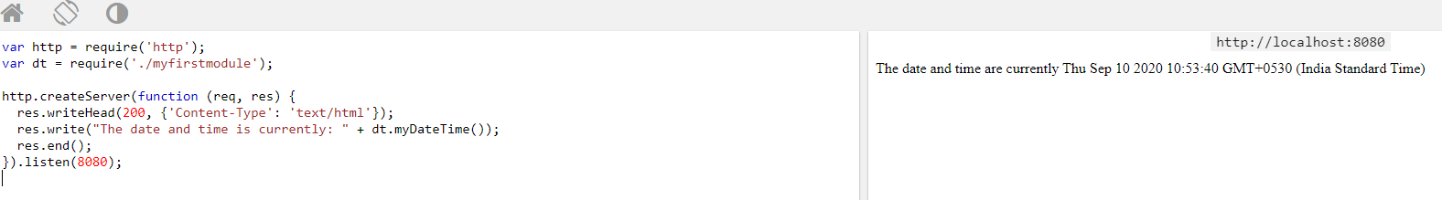

Slide 28
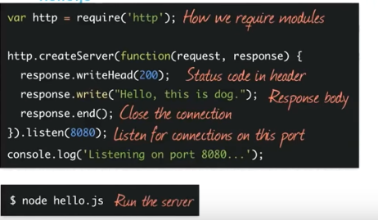
Step 2 &3: Create Server, Read request and return response
We use the created http instance and call http.createServer() method to create a server instance and then we bind it at port 8081 using the listen method associated with the server instance. Pass it a function with parameters request and response.

